Slide 1


Deep Learning on a Novel Ising Model to Study Arctic Sea Ice Dynamics
By Ellen Wang
(Horace Mann School, Class of 2025)

Slide 2
Presentation Roadmap
01
06
02
03
07
08
MCMC Simulation
Significance
05
The critical importance of investigating sea ice loss
The procedures and the programming packages
Data
CNN Architecture
The data source and the focus area of this study
Neural Network architecture and training process
Physics Model
Results
The classical Ising Model and new features
The simulation results and the measures of similarity
04
Convolutional Neural Networks
Conclusions
Deep learning model to solve the inverse Ising problem
Discussions and future work

Slide 3
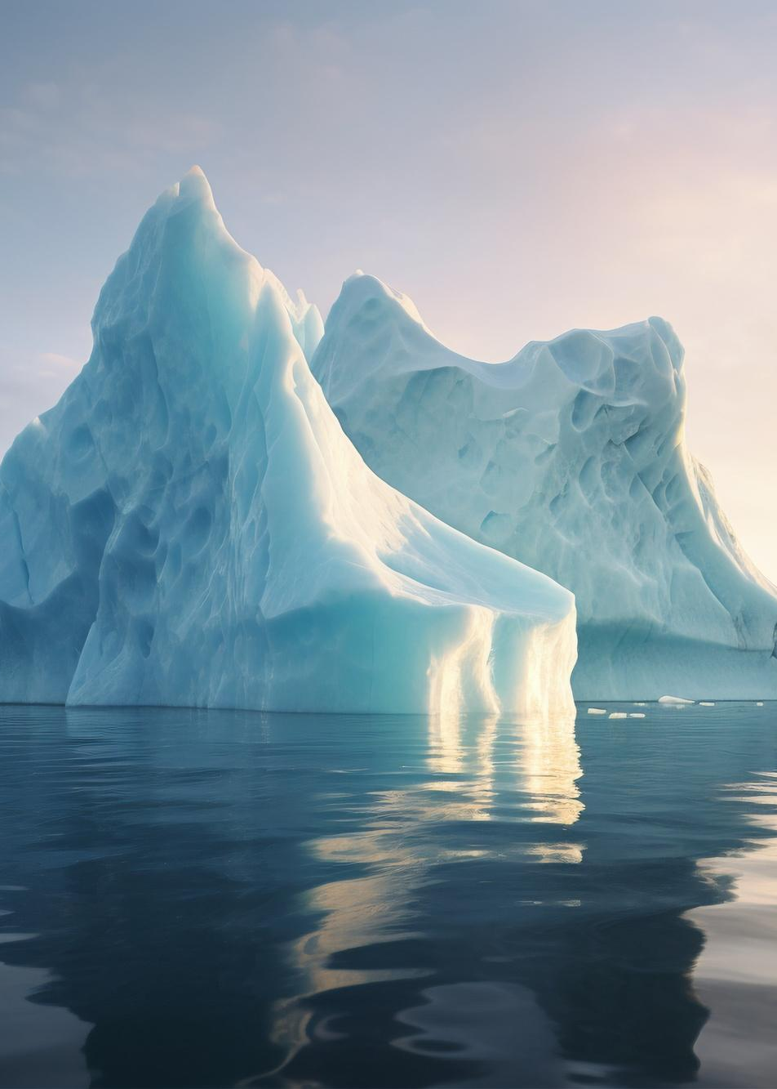
01
Significance
Why sea ice dynamics?

Slide 4
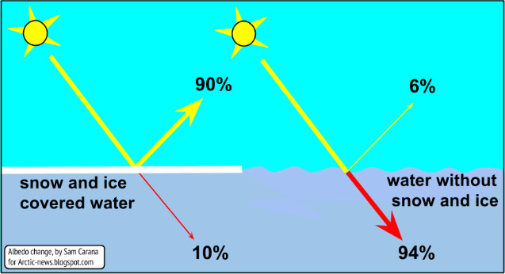
Sea Ice for climate change
Ice coverage is widely acknowledged as a crucial indicator of global climate change
Light-colored ice is essential to maintaining the cold temperature in the polar regions and subsequently the energy balance around the globe
Albedo, latent heat, insolation and more (2012)
https://arctic-news.blogspot.com/p/albedo.html

Slide 5
12.3% 95%
NASA Estimation
Over the past 30 years, the oldest and thickest ice in the Arctic has declined by a stunning 95%.
September Arctic sea ice is now shrinking at a rate of 12.3% per decade

Slide 6

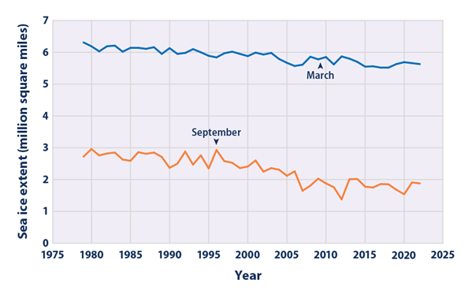
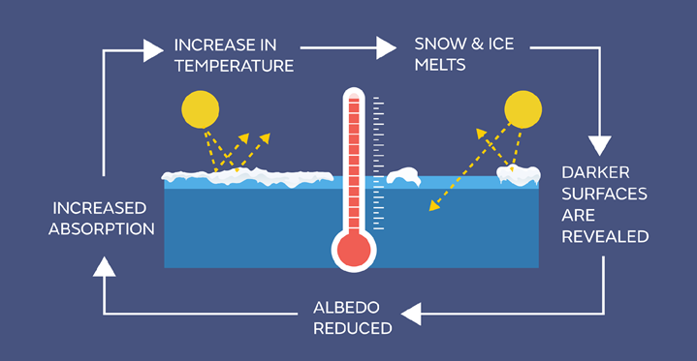
Alarming sea ice loss has been detected in recent years
The continued decline in ice coverage may lead to the feedback loop effect that furthers global warming and harms ecosystems
Climate change indicators: Arctic Sea Ice | US EPA. (n.d.)
https://www.epa.gov/climate-indicators/climate-change-indicators-arctic-sea-ice
Sea ice in the climate system. Met Office. (n.d.). https://www.metoffice.gov.uk/research/climate/cryosphere-oceans/sea-ice/index

Slide 7
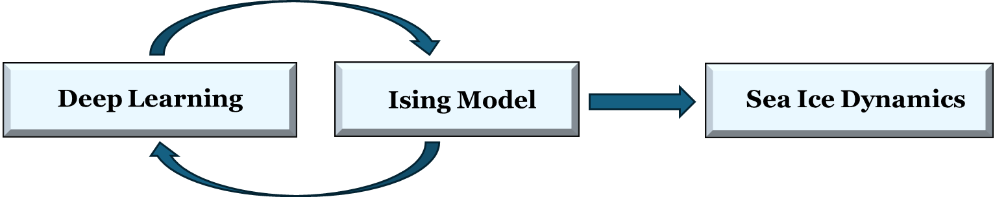
Sea ice loss has been detected in recent years, a crucial indicator of global climate change; it is critically urgent to better model the sea ice dynamics.
Many sea ice studies use machine learning without identifying the key physical principles underlying the dynamics.
This pioneering research combines the classical Ising model in statistical physics with deep learning, unleashing their strong explanatory power of capturing the sea ice transition dynamics.
Research framework as follows:

Slide 8
02
Data
Public dataset and the focus area for our study

Slide 9
Data
Sea ice data has been diligently collected by the National Snow and Ice Data Center (NSIDC).
Their publicly accessible data, called “Near-Real-Time DMSP SSMIS Daily Polar Gridded Sea Ice Concentrations” (NRTSI) records daily sea ice concentrations for both the Northern and Southern Hemispheres. These concentrations are generated based on the microwave brightness temperature detected by NASA’s satellite sensor.
Each NRTSI file contains a lattice of 448 rows by 304 columns, covering a large earth surface area with the north pole at the center. Each grid cell represents an area of approximately 25 kilometers by 25 kilometers, with an integer value from 0 to 250 that indicates the fractional ice coverage scaled by 250.

Slide 10
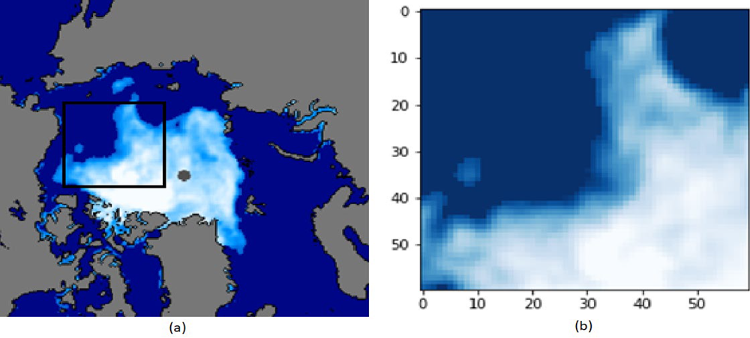
Part of the NRTSI data on Sept 16th, 2022
(b) The focus area for this study (black box), a 60x60 square lattice covering approximately 2.25 million square kilometers

Slide 11
03
Physics Model
The classical Ising Model and new features

Slide 12

Ising Model
Can you see the similarity between
ice-water transition and magnets?

Slide 13
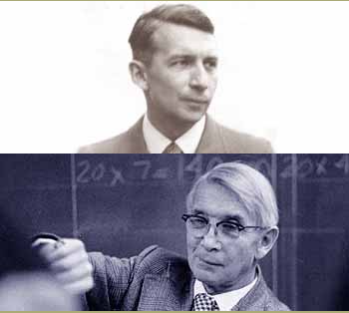
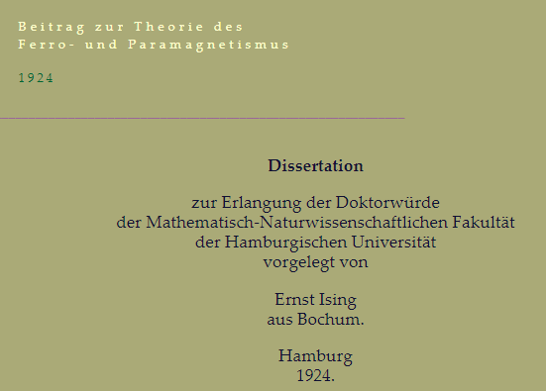
Ising Model
A brief history of Ising Model
Physicist Wilhelm Lenz proposed this whole idea of constructing a mathematical model to analyze the equilibrium and phase transition in magnetic systems.
Ising was able to solve the model in his 1924 Ph.D. thesis, but the 2-D version was only given an analytic description much later, by Lars Onsager (1944).
In recent years, Ising model has seen wide success in many fields outside of physics, including biology, environmental science, machine learning, social science etc.
Ising Model proves to be an excellent model to investigate the ice/water evolution, given their reversible phase transitions year-round

Slide 14
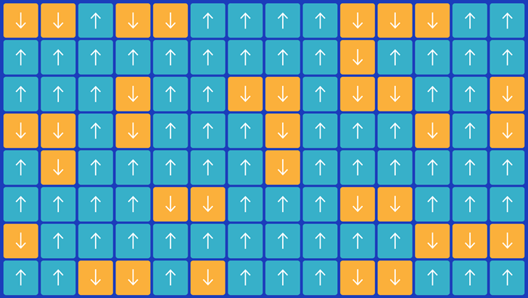
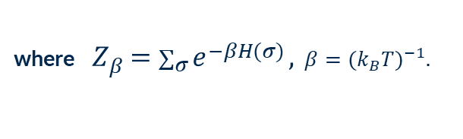

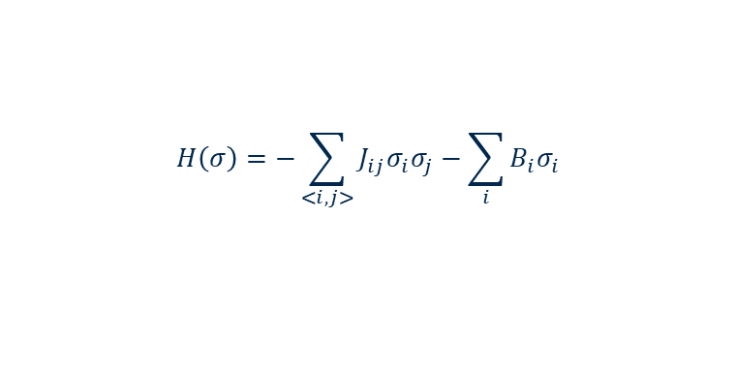
Ising Model: Theoretical Framework
The Hamiltonian for the lattice $σ$ in a standard IM is given as
$$H\left(σ\right)=−\sum_{<i,j>}{J_{ij}σ_{i}σ_{j}}−\sum_{i}{B_{i}σ_{i}}$$
The probability of any configuration follows
$$P_{β}\left(σ\right)=\frac{e^{−βH\left(σ\right)}}{Z_{β}},$$
where $Z_{β}=\sum_{σ}{e^{−βH(σ)}},$ $β={(k_{B}T)}^{−1}.$
Quanta Magazine (2021, February 26)
https://www.quantamagazine.org/the-cartoon-picture-of-magnets-that-has-transformed-science-20200624/

Slide 15
Ising Model: New Features
The spin values in our study are allowed to be any real number between +1 (100% water) and -1 (100% ice).
In this continuous Ising Model, the challenge to capture the random distribution of the post-flip spin value is addressed by introducing an innovative inertia factor I, which determines the probability of each flip as
$${P_{flip}=e}^{−β\left(H_{ν}−H_{μ}+ I \right|σ_{i}^{′}− σ_{i} |)}$$
The energy needed to overcome the inertia of the spin change, a term representing the natural resistance to state change, or the latent heat needed for the water/ice phase transition in classical thermodynamics.
The system Hamiltonian before and after the flip

Slide 16
04
Convolutional Neural Networks
Deep learning model to sovle the inverse Ising problem

Slide 17
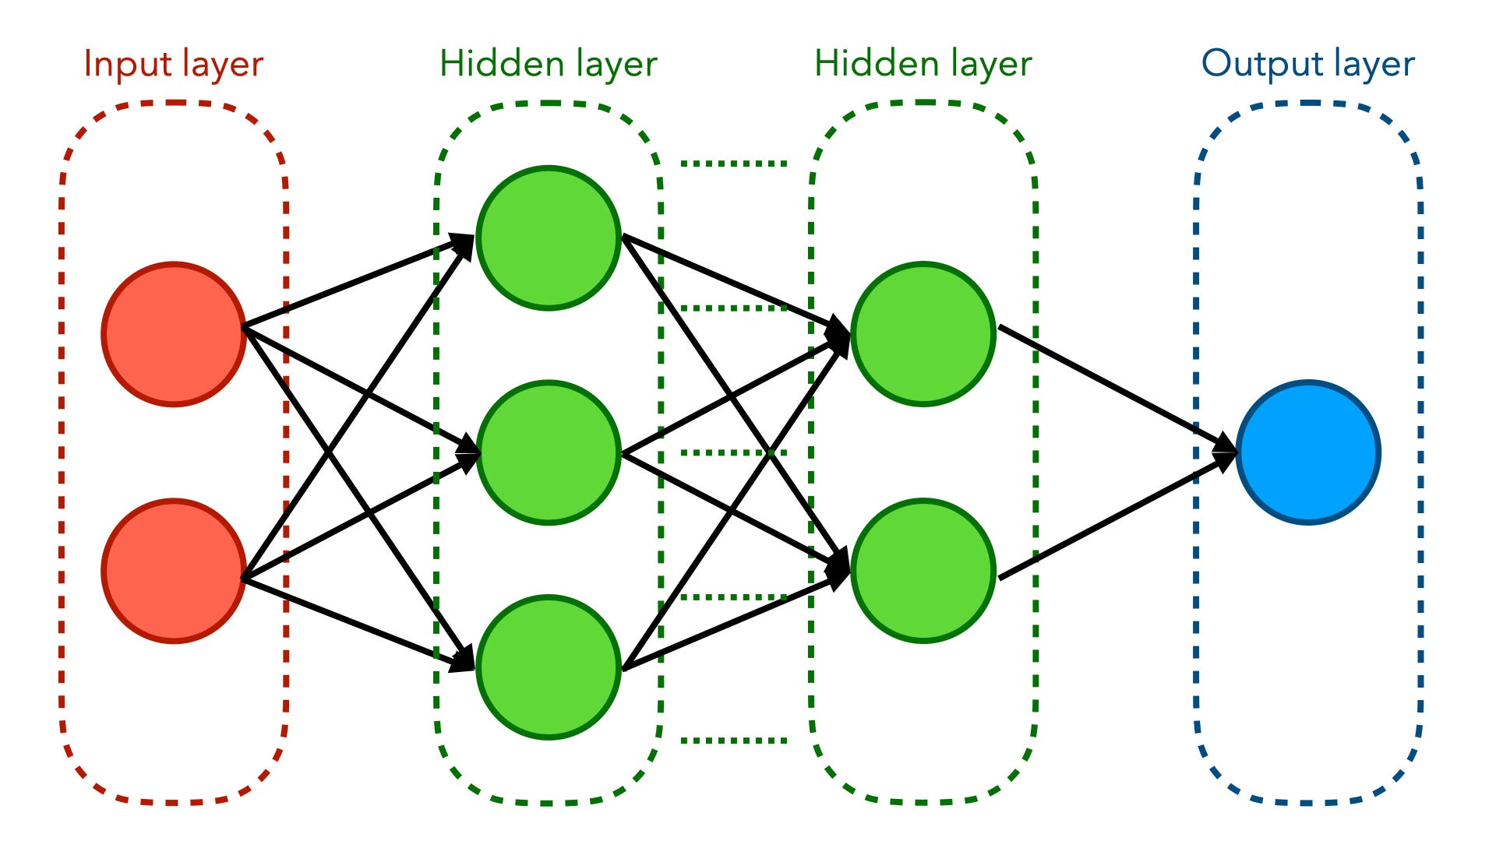
Artificial Neural Networks
Artificial neural networks (ANN) are a branch of artificial intelligence and machine learning inspired by the structure and functioning of the human brain.
ANN consists of a collection of neurons that are interconnected
Most modern deep learning models are based on multi-layered ANNs.
Illustration of multi-layered neural network
https://towardsdatascience.com/an-illustrated-guide-to-artificial-neural-networks-f149a549ba74

Slide 18
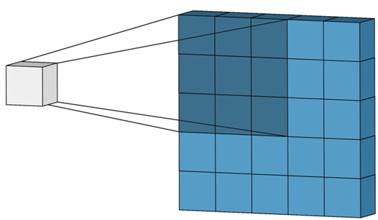
Convolutional Neural Networks
Convolutional Neural Networks (CNN) are a type of ANN specialized to analyze data with grid-like topology
CNN revolutionized computer vision in the 2010s
The key of CNNs is convolutional layers, which employ a mathematical operation called convolution. A convolutional layer consists of kernels, or filters. The kernels slide along the input grid and compute the weighted sums, followed by an activation function to produce outputs.
Illustration of convolution operation:
a (3x3) kernel applied to a (5x5) image
https://towardsdatascience.com/convolutional-neural-networks-explained-9cc5188c4939

Slide 19
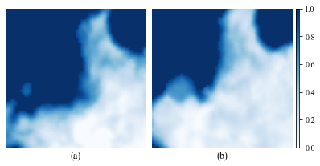
CNN: Solve the Inverse Ising Problem
The initial and the final target states of an IM lattice simulation run, for instance , from (a) Sept 16th, 2022 to (b) Oct 1st, 2022
Can we train a deep learning model to recognize the differential of the initial and final state ice/water configurations, and to predict the Ising model parameters?

Slide 20
05
MCMC Simulation
The procedures and the programming pachakges

Slide 21
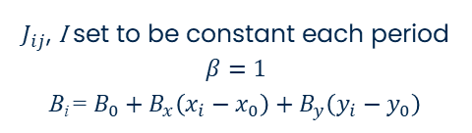
Simulation Setup
1
2
3
Prep
Period
Parameters
Conversion of NRTSI data into 60x60 Ising lattice
Chosen to be consistenly half a month apart
$J_{ij}$, I set to be constant each period
$$β=1$$
B_{i} = $B_{0}+B_{x}\left(x_{i}−x_{0}\right)+B_{y}\left(y_{i}−y_{0}\right)$
Ready!

Slide 22
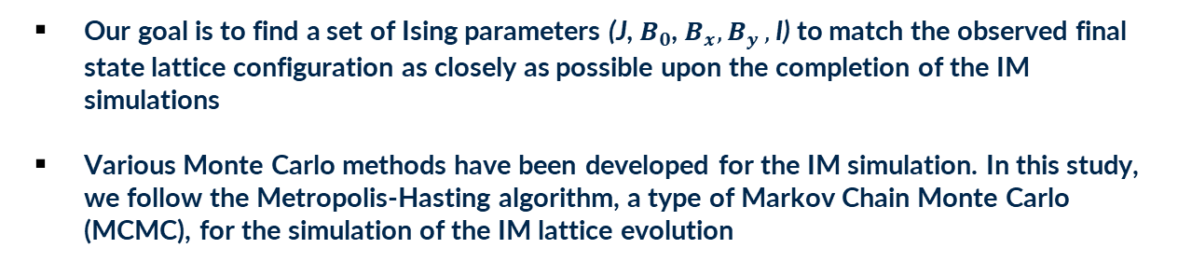
Simulation Method: Metropolis MCMC
The initial and the final target states of an IM lattice simulation run, for instance , from (a) Sept 16th to (b) Oct 1st, 2022
Our goal is to find a set of Ising parameters (J, $B_{0}$,${ B}_{x}{,B}_{y},$I) to match the observed final state lattice configuration as closely as possible upon the completion of the IM simulations
Various Monte Carlo methods have been developed for the IM simulation. In this study, we follow the Metropolis-Hasting algorithm, a type of Markov Chain Monte Carlo (MCMC), for the simulation of the IM lattice evolution

Slide 23

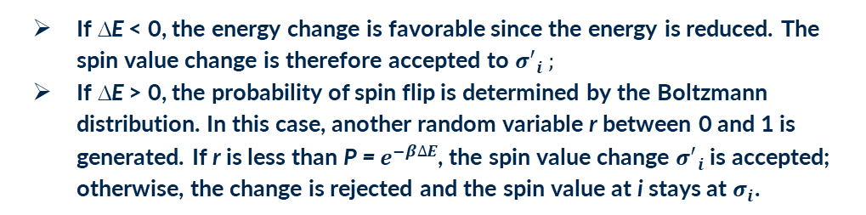
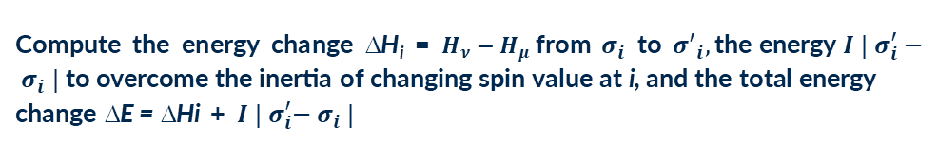
Simulation Steps
Select cell i at random from the 2-D lattice of the focus area. Let spin value of this cell be $σ_{i}$.
1
Repeat these MC steps 50,000 times for each semi-monthly simulation period
Generate another random variable ${σ^{′}}_{i}$ between $−1$ and +1.
2
Compute the energy change ∆H_{i} = $H_{ν}−H_{μ}$from $σ_{i}$ to ${σ^{′}}_{i},\text{the} \text{energy}{ I | σ}_{i}^{′}− σ_{i} | \text{to} \text{overcome} \text{the} \text{inertia} \text{of} \text{changing} \text{spin} \text{value} \text{at} \text{i}\text{, }\text{and} \text{the} \text{total} \text{energy} \text{change} \text{∆}\text{E}\text{ = ∆}\text{Hi}$ + ${ I | σ}_{i}^{′}− σ_{i} |$
3
4
If ∆E < 0, the energy change is favorable since the energy is reduced. The spin value change is therefore accepted to ${σ^{′}}_{i} ;$
If ∆E > 0, the probability of spin flip is determined by the Boltzmann distribution. In this case, another random variable r between 0 and 1 is generated. If r is less than P = $e^{−β∆E}$, the spin value change ${σ^{′}}_{i}$ is accepted; otherwise, the change is rejected and the spin value at i stays at $σ_{i}$.

Slide 24
06
CNN Architecture
Neural Network architecture and training process

Slide 25
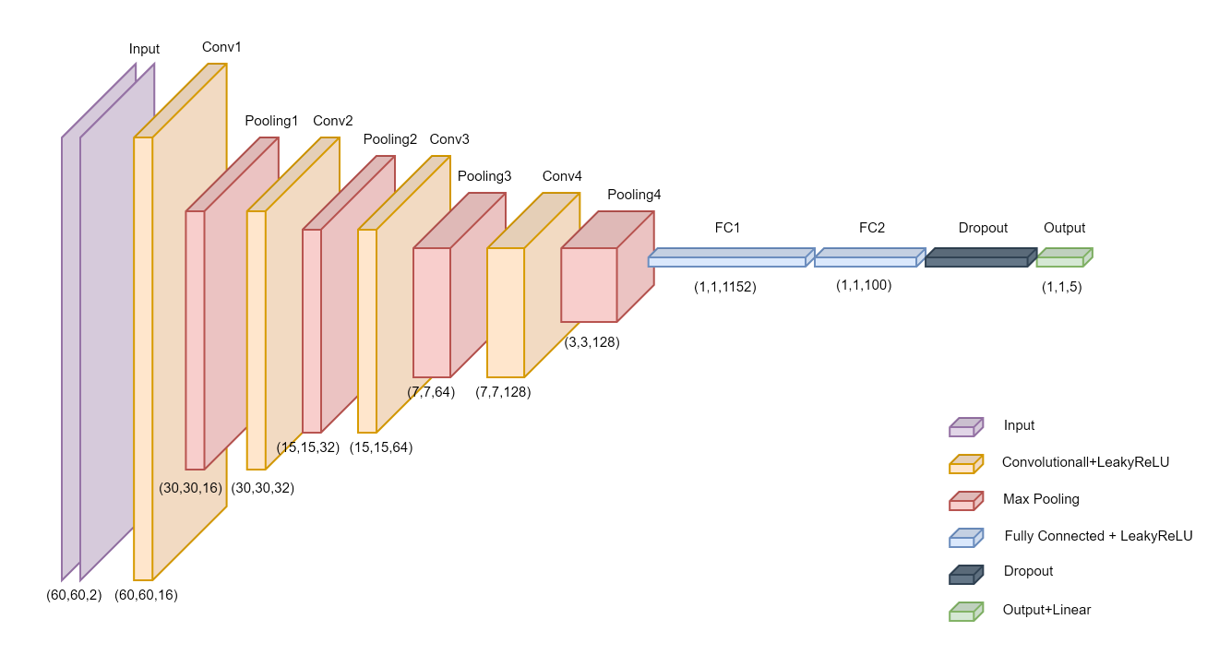
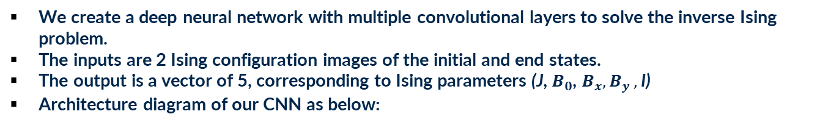
CNN Architecture
We create a deep neural network with multiple convolutional layers to solve the inverse Ising problem.
The inputs are 2 Ising configuration images of the initial and end states.
The output is a vector of 5, corresponding to Ising parameters (J, $B_{0}$,${ B}_{x}{,B}_{y},$I)
Architecture diagram of our CNN as below:

Slide 26
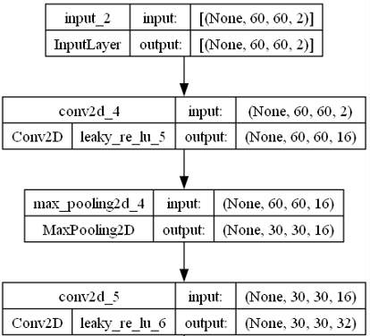
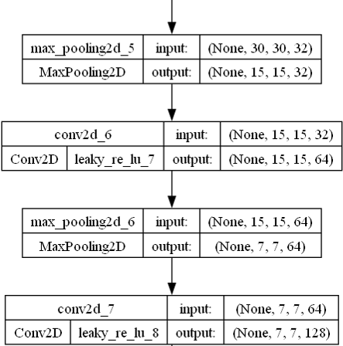
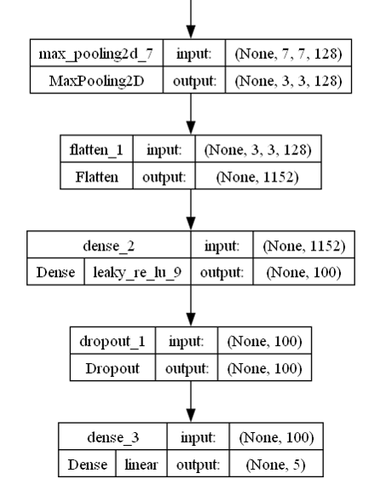
CNN Architecture
Architecture diagram of our CNN – plot from Keras/Tensorflow
Total number of trainable parameters: 213,201

Slide 27
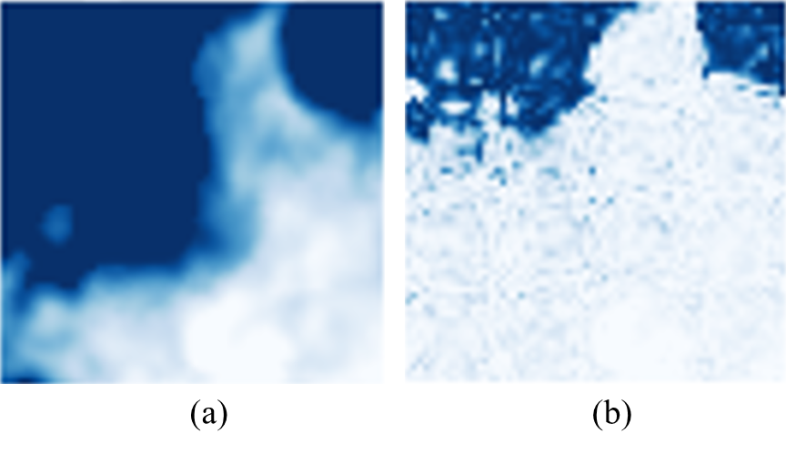
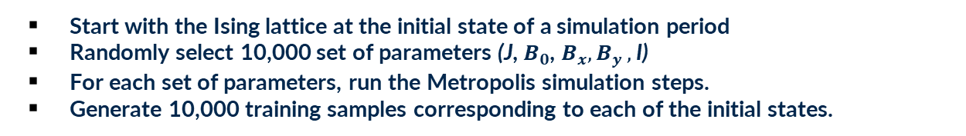
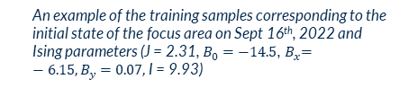
CNN Training Data
Training neural networks requires a substantial amount of data. Where do we find enough data for CNN training?
Ising model itself offers infinite training data!
Start with the Ising lattice at the initial state of a simulation period
Randomly select 10,000 set of parameters (J, $B_{0}$,${ B}_{x}{,B}_{y},$I)
For each set of parameters, run the Metropolis simulation steps.
Generate 10,000 training samples corresponding to each of the initial states.
An example of the training samples corresponding to the initial state of the focus area on Sept 16th, 2022 and Ising parameters (J = 2.31, $B_{0}=−14.5$,${ B}_{x}=−6.15{,B}_{y}=0.07,$I = 9.93)

Slide 28
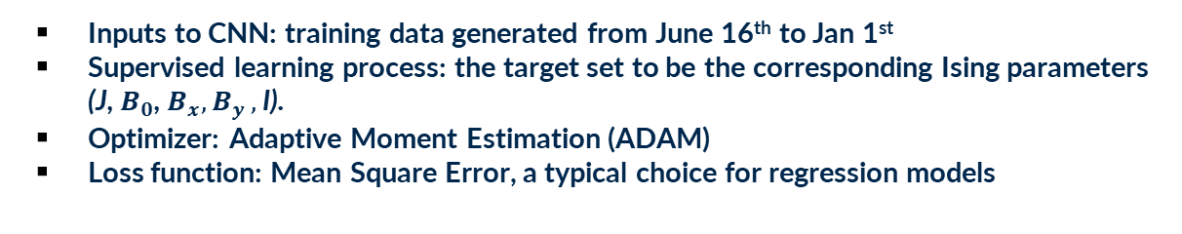
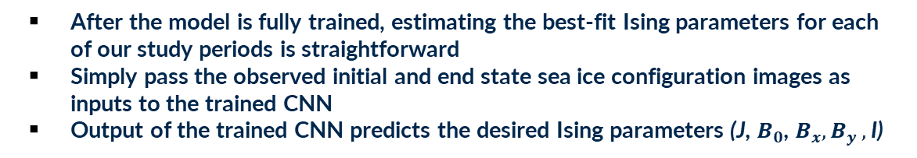
CNN Training and Prediction
Inputs to CNN: training data generated from June 16th to Jan 1st
Supervised learning process: the target set to be the corresponding Ising parameters (J, $B_{0}$,${ B}_{x}{,B}_{y},$I).
Optimizer: Adaptive Moment Estimation (ADAM)
Loss function: Mean Square Error, a typical choice for regression models
After the model is fully trained, estimating the best-fit Ising parameters for each of our study periods is straightforward
Simply pass the observed initial and end state sea ice configuration images as inputs to the trained CNN
Output of the trained CNN predicts the desired Ising parameters (J, $B_{0}$,${ B}_{x}{,B}_{y},$I)

Slide 29
07
Results
Simulation results and comparisons

Slide 30
Simulation Results: 2022
CNN Predicted Ising parameters of 2022 sea ice evolution

Slide 31
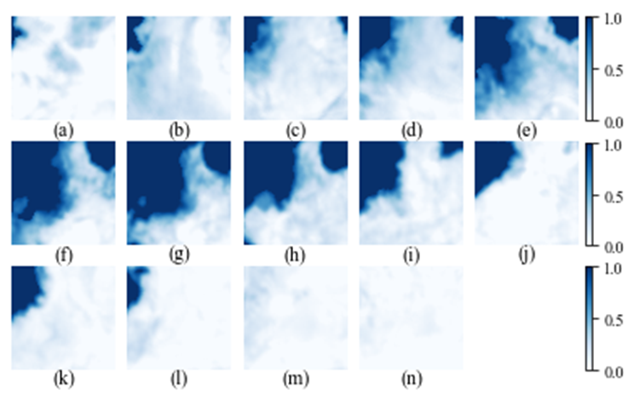
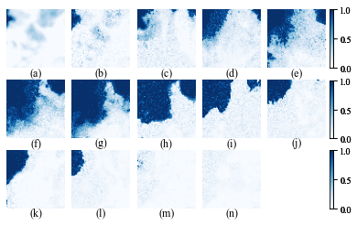
Simulation Results: 2022
The actual (left) and the simulated (right) semi-monthly evolution of sea ice in our focus area in 2022: (a) June 16th, 2022, (b) July 1st, (c) July 16th, (d) Aug 1st, (e) Aug 16th, (f) Sept 1st, (g) Sept 16th, (h) Oct 1st, (i) Oct 16th, (j) Nov 1st, (k) Nov 16th, (l) Dec 1st, (m) Dec 16th, 2022, and (n) Jan 1st, 2023

Slide 32
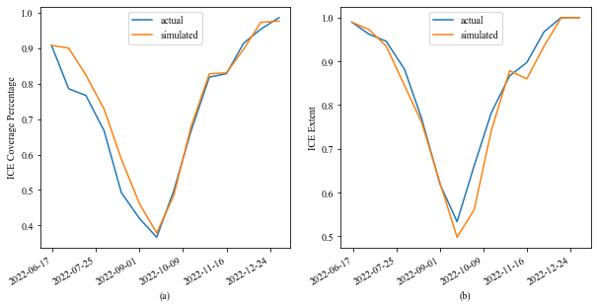
Simulation Results: 2022 Similarity
Ice Coverage Percentage = Arithmetic average of ice % over whole lattice
Ice Extent = Fraction of the lattice cells that is covered by at least 15% ice
The ice coverage percentage (a) and the sea ice extent (b) in our focus area from June 16th, 2022 to Jan 1st, 2023

Slide 33
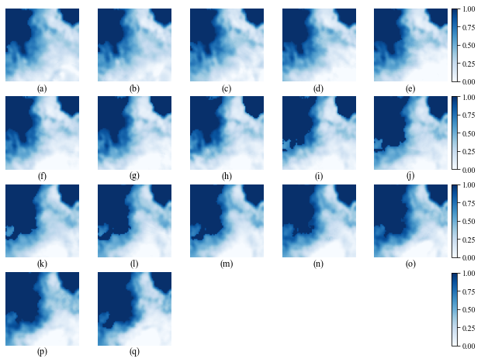
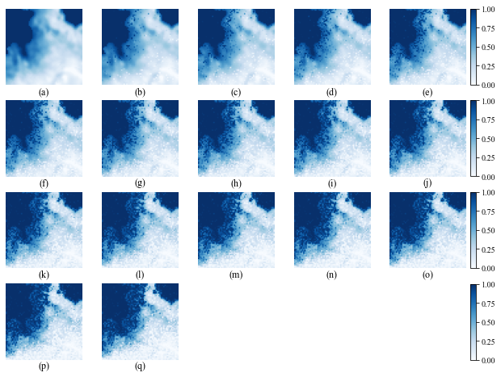
Simulation Results: 2022 Daily Dynamics
The actual (left) and the simulated (right) daily evolution of sea ice in our focus area during a melting cycle from (a) Aug 16th, 2022 to (q) Sept 1st, 2022.

Slide 34
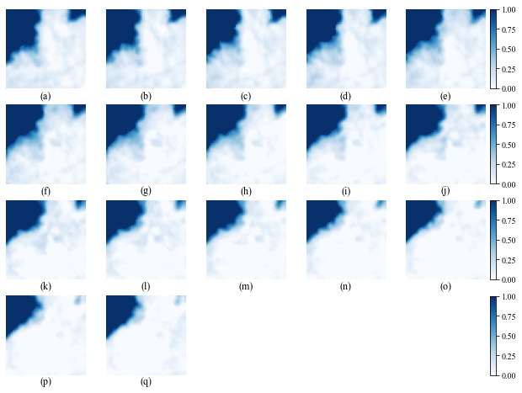
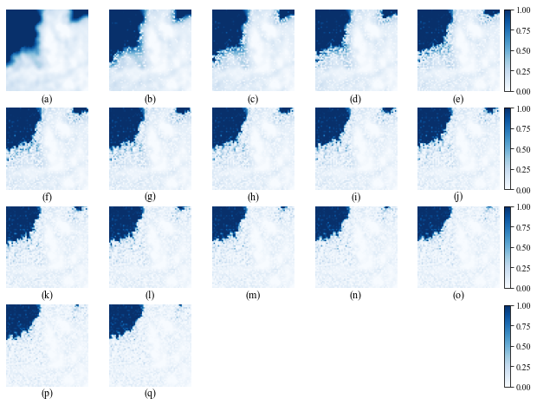
Simulation Results: 2022 Daily Dynamics
The actual (left) and the simulated (right) daily evolution of sea ice in our focus area during a freezing cycle from (a) Oct 16th, 2022 to (q) Nov 1st, 2022

Slide 35
Simulation Results: 2023
July 2023 has just been reported as the hottest month of the earth on record
2023 is the hottest year on record by a significant margin
CNN predicted Ising Parameters of 2023 sea ice evolution

Slide 36
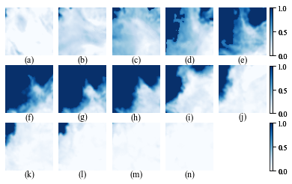
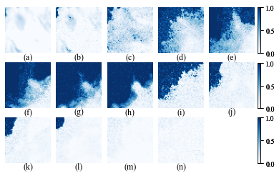
Simulation Results: 2023
The actual (left) and the simulated (right) semi-monthly evolution of sea ice in our focus area in 2023: (a) June 16th, 2023, (b) July 1st, (c) July 16th, (d) Aug 1st, (e) Aug 16th, (f) Sept 1st, (g) Sept 16th, (h) Oct 1st, (i) Oct 16th, (j) Nov 1st, (k) Nov 16th, (l) Dec 1st, (m) Dec 16th, 2023, and (n) Jan 1st, 2024

Slide 37
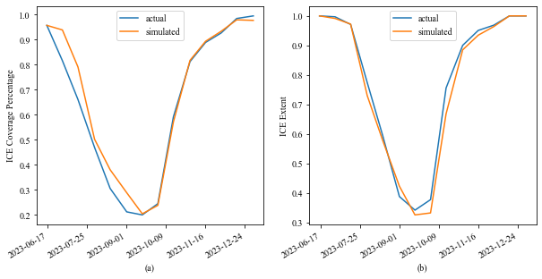
Simulation Results: 2023 Similarity
The ice coverage percentage (a) and the sea ice extent (b) in our focus area from June 16th, 2023 to Jan 1st, 2024

Slide 38
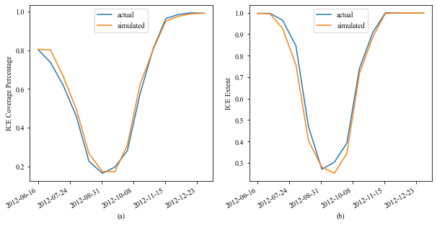
Simulation Results: 2012 Ice Extent
2012 recorded the lowest Arctic sea ice extent in recorded history
The ice coverage percentage (a) and the sea ice extent (b) in our focus area from June 16th, 2012 to Jan 1st, 2013

Slide 39
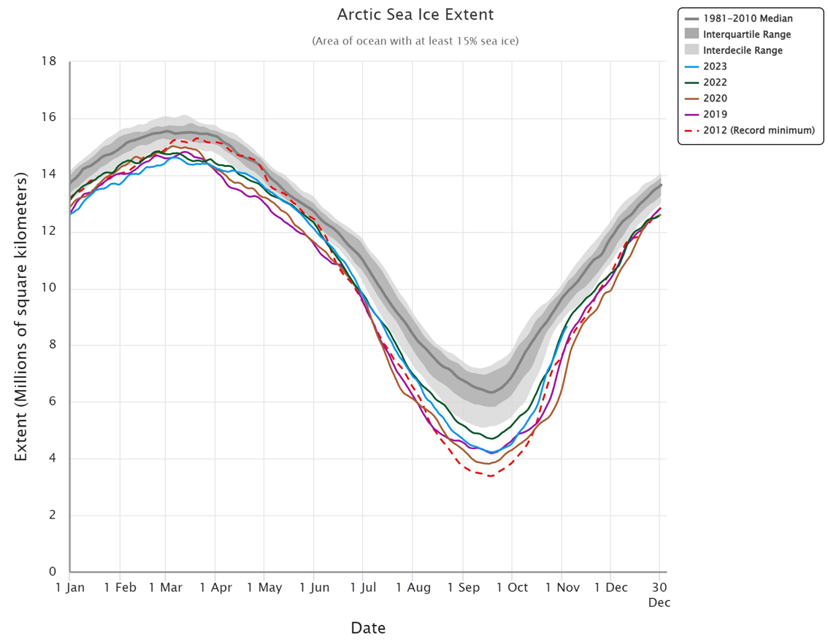
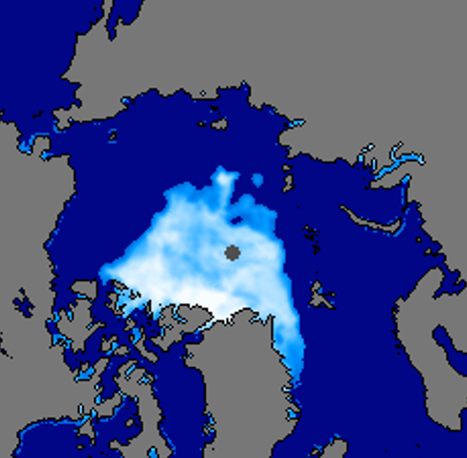
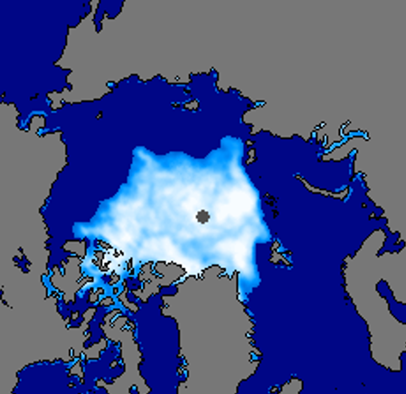
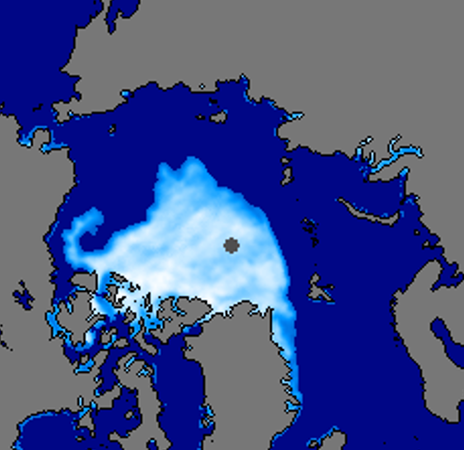
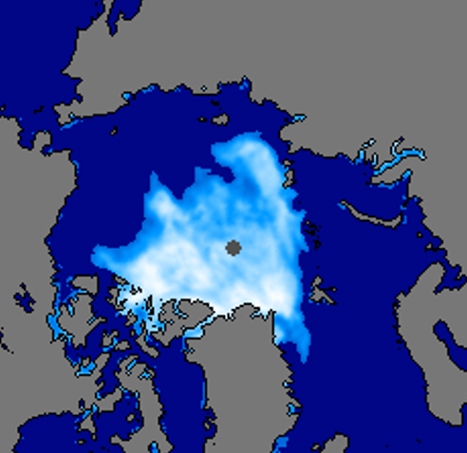
Official Arctic Sea Ice Extent History
2012
2019
2020
2023
For the entire Arctic region in NRTSI data, Sept ice extent in 2023 was recorded to be the fourth lowest historically
https://nsidc.org/arcticseaicenews/

Slide 40
Comparison of sea ice extent btw 2023 & 2012
2023 is the hottest year on record
2023 did not break the record-low Arctic sea ice extent level set in 2012
However, 2023 set the second lowest ice extent for our focus area (For the entire Arctic region not limited to our focus area, 2023 marks the 6th-lowest ice extent in history; all 6 minimums are well within small margins)
2023 not breaking ice extent record offers no reason for us to be optimistic about the future.
In fact, in the 45-year-satellite record from 1979 to 2023, 17 of the lowest minimums have all occurred in the last 17 years
Will the next decades see much higher temperature and much lower ice extent! ?
Will we see an ice-free Arctic Ocean? If so, when?

Slide 41
08
Conclusions
Discussions and future work

Slide 42
Conclusions & Discussions
Physics Model
MCMC Simulation
Continuous spin values and an innovative inertia factor introduced to a 2-D Ising Model.
Metropolis-Hastings algorithm utilized to simulate the dynamics of the sea ice evolution in a focus area in the Arctic region.
Deep Learning
Results
Train a deep convolutional neural network to learn the Ising interaction parameters
Excellent similarity with the actual sea ice dynamics, based on the average ice coverage and the ice extent metrics.

Slide 43
Conclusions & Discussions
When trained with CNN, the continuous-spin Ising model with the novel inertia factor proves to have extraordinary power to replicate and explain sea ice dynamics.
The Ising parameters predicted by CNN reveal the substantial impact of the external forces in climate change research.
The study presents ample possibilities to further enhance the physics modeling of the Arctic sea ice dynamics.
This research validates the vast potential of coupling classical physics models with modern deep learning technology in environmental studies and other disciplines.

Slide 44
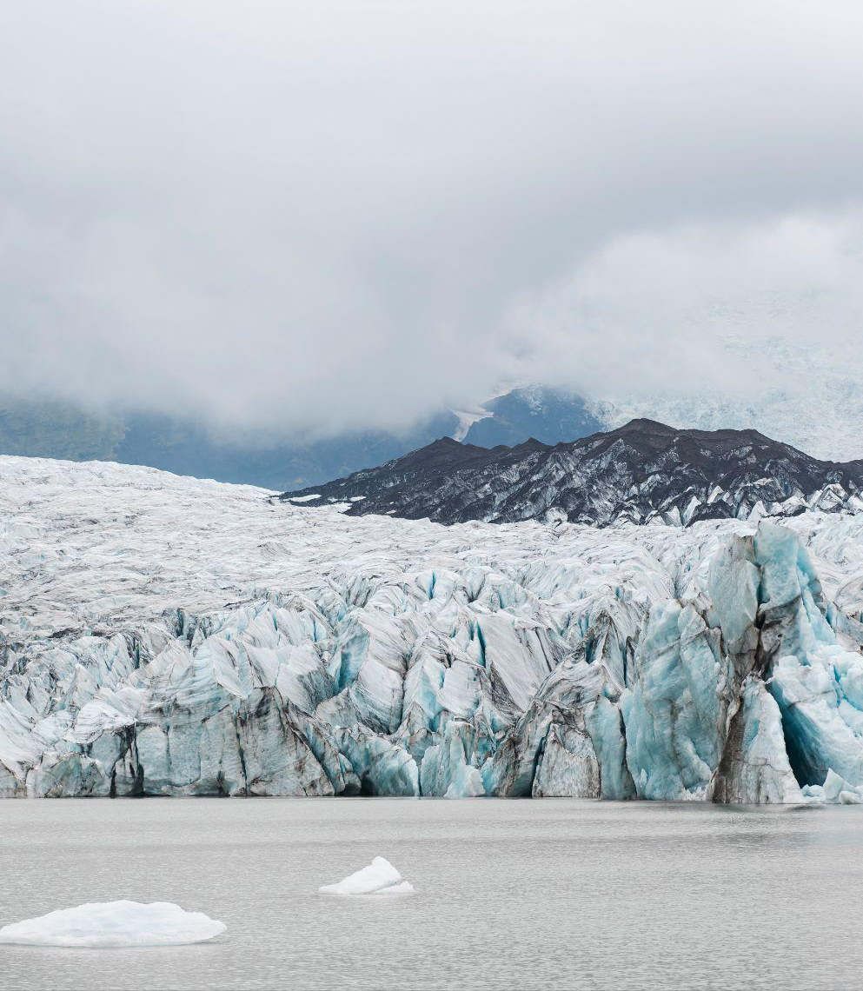
Will the “Blue Ocean Event” happen, i.e., will we see an “ice-free” Arctic Ocean?
Discussion 1
Some research predicts that this can happen in the 2030s!

Slide 45
Larger deep learning model
Discussion 2
A small CNN (~200,000 parameters only in this study) trained on the CPU of a PC demonstrates amazing power to solve for the Ising parameters and to explain the complex sea ice dynamics.
Deeper and larger neural networks shall offer more power to learn enriched Ising parameters

Slide 46
Explore Quantum Ising Model (QIM), a.k.a. Transverse Field Ising Model to harness the exponentially growing power of quantum computing?
Discussion 3

Slide 47
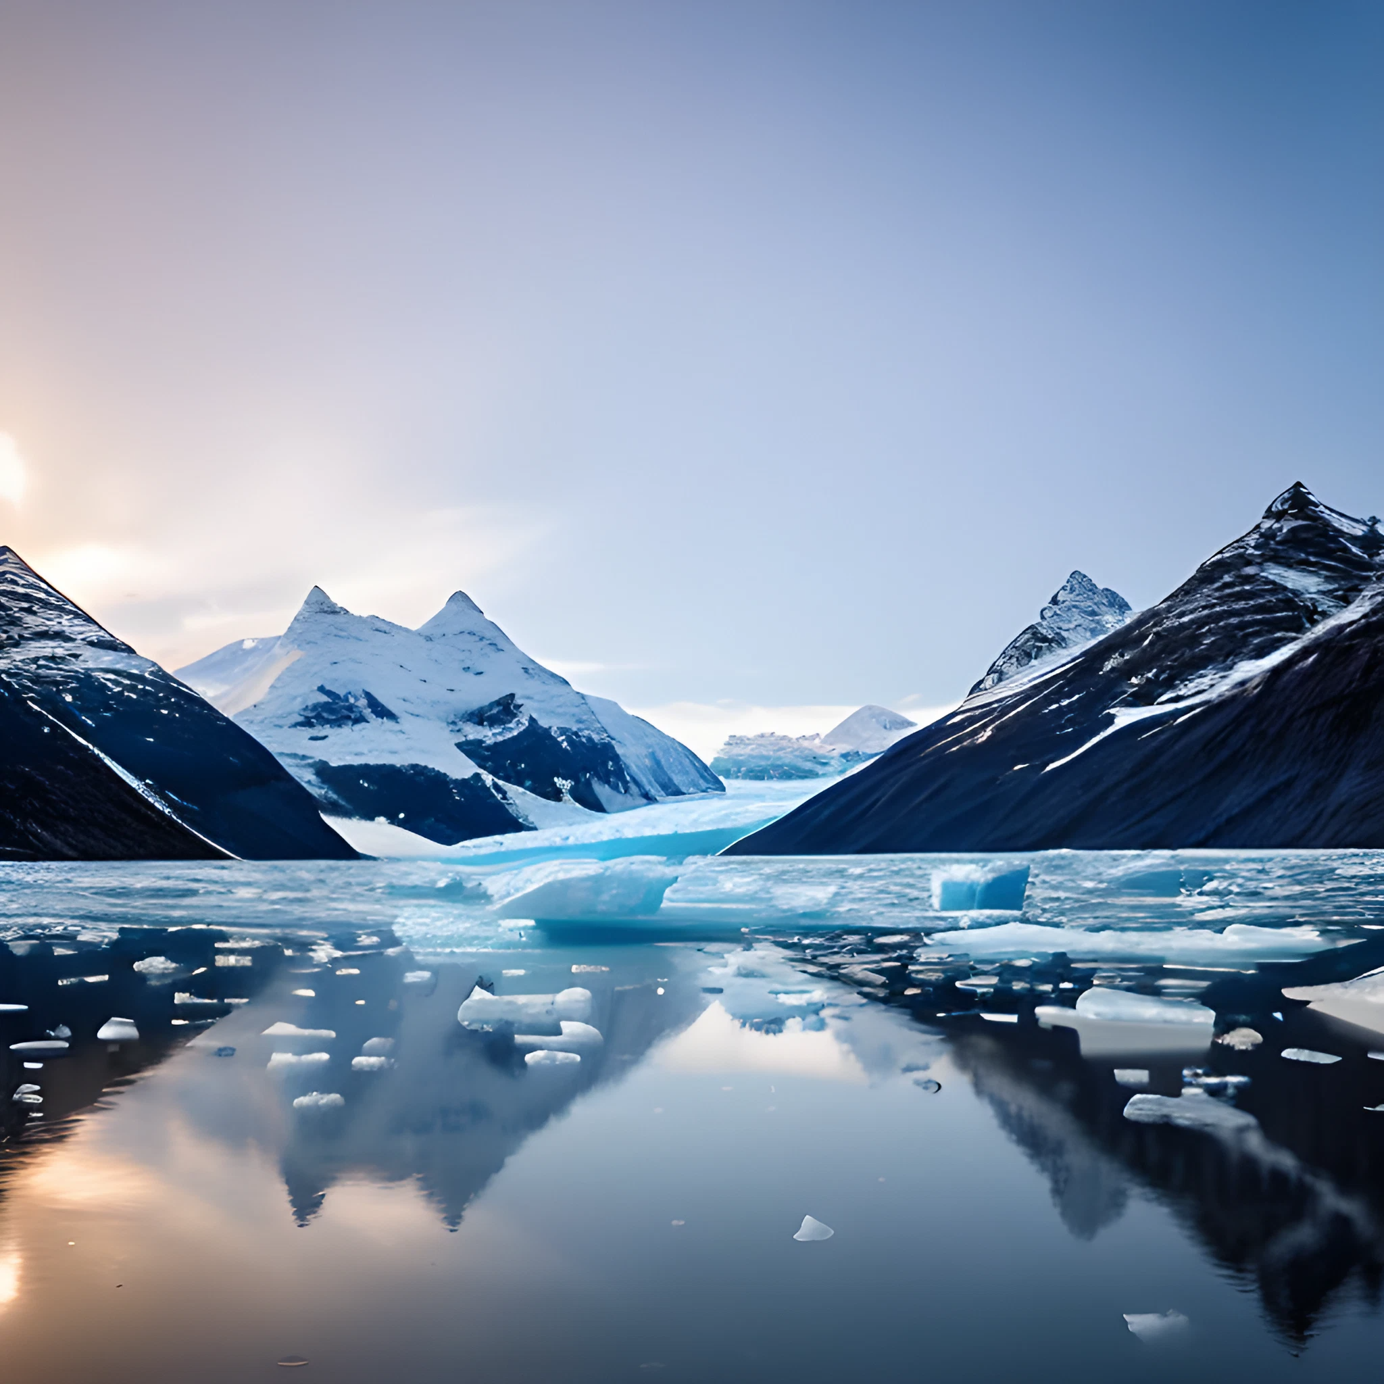
Thanks!
Many thanks to:
National Snow and Ice Data Center (NSIDC)
National Aeronautics and Space Administration (NASA)
Prof. Joan Wang at Xiamen Univ. Malaysia
Dr. Alyssa Shearer at Horace Mann School
Dr. Sergii Strelchuk at the Univ. of Cambridge

